Slide 1
P-train project update 6
Tuyen Nguyen
Miek Adriaens
1/19

Slide 2
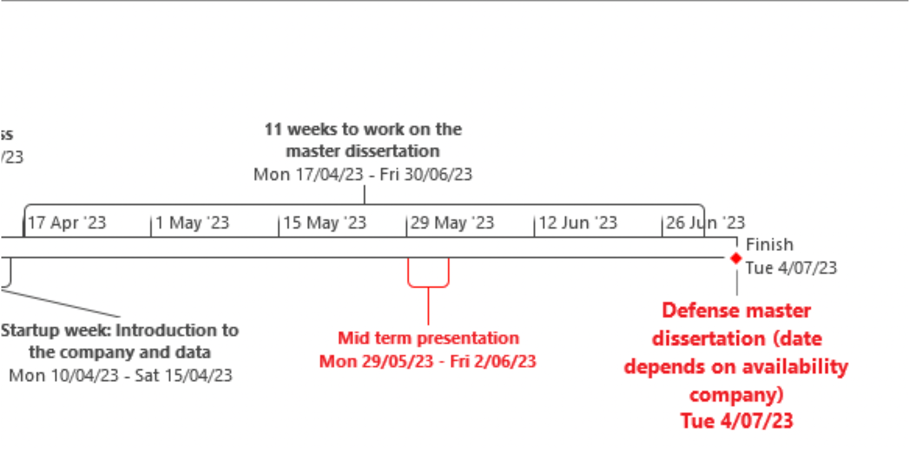

Planning (1)
2/19

Slide 3
Planning (2)
May 15-21:
Implementing dynamic/personalised features (cont.)
feature selection
May 22-28: Mid term preparation: line section performance, P-train performance
May-June 29-4: Mid term presentation
June 5-11:
June 12-18:
June 19-25:
June-July 26-30: finalising
July 3-7: Defence
3/19

Slide 4
P-train Punctuality Project Recap
We are working with the trains punctuality and journey data
Central questions:
What impacts do P-trains have?
What makes a good P-train?
What makes a bad P-train?
If we create a new P-train, will it be good or bad?
4/19

Slide 5
Our model:
Did a P-train make at least 1 other train late (>= 6 mins delay)?
Newest Features:
Individualised:
times_ahead:
How many times a P-train was 5 minutes ahead of another train on a specific line section, travelling in the same direction
pagerank:
Importance in the network, where trains are connected by sharing a line section and direction
trains_behind:
How many times a P-train was 5 minutes behind another train on a specific line section, travelling in the same direction
5/19

Slide 6

Line Section and Direction
We only account for trains going from a PTCAR, to another PTCAR on the same section and direction
Different directions can pass eachother
Unique key for this: current ptcar + upcoming line section + upcoming ptcar
ptcar235_sec1200_ptcar237
next ptcar
within 5 mins?
current ptcar
237
235
236
section 1200
6/19

Slide 7
Line Section and Direction: Usage
Train Performance:
Create network based on trains sharing line section & direction
Network variables as predictors of P-train causing delay
Line Section Performance
Line sections and directions one-hot-encoded
diagnose where P-trains cause problems in the network
7/19

Slide 8
Train Performance
8/19

Slide 9
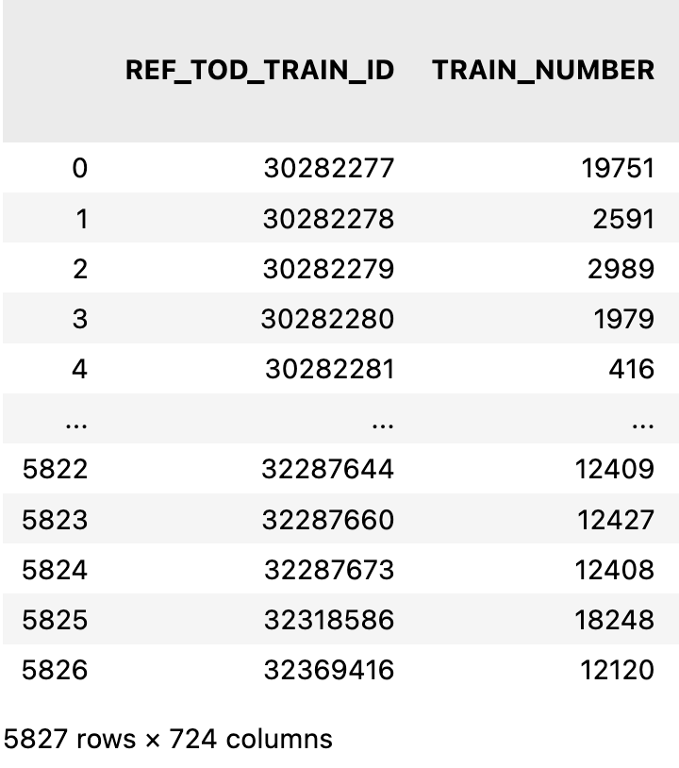
Network: Methodology
Before: computational issues
Solved by using one representative train per train number
modal trajectory
simplification
9/19

Slide 10
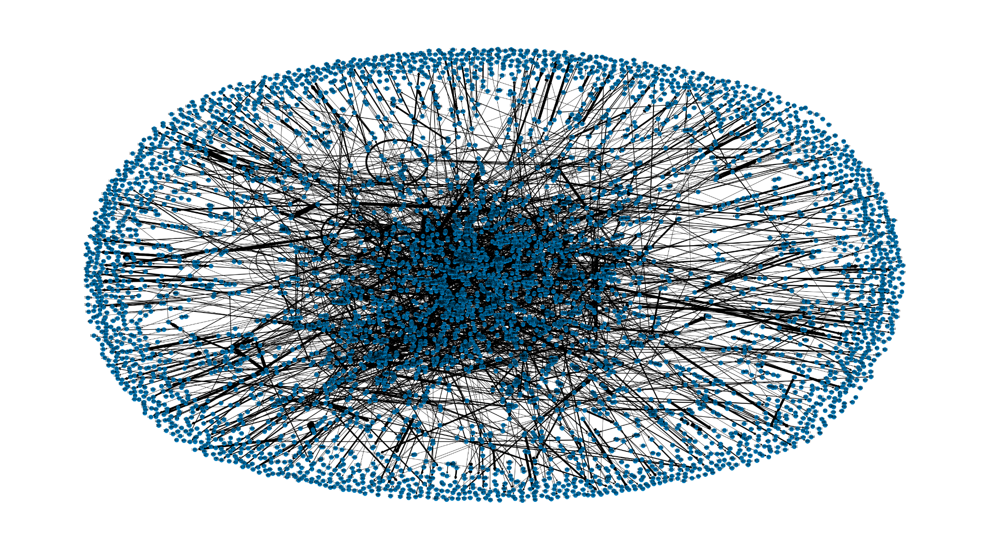
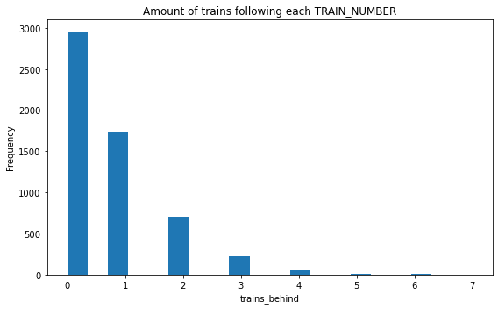
Network: Pagerank
Connection:
Trains share a line section and direction, close in time (5 mins)
Direction:
From following train to train in front
10/19

Slide 11
11/19

Slide 12
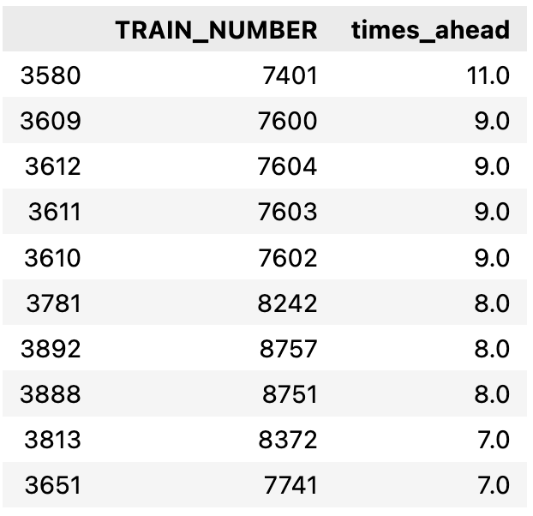
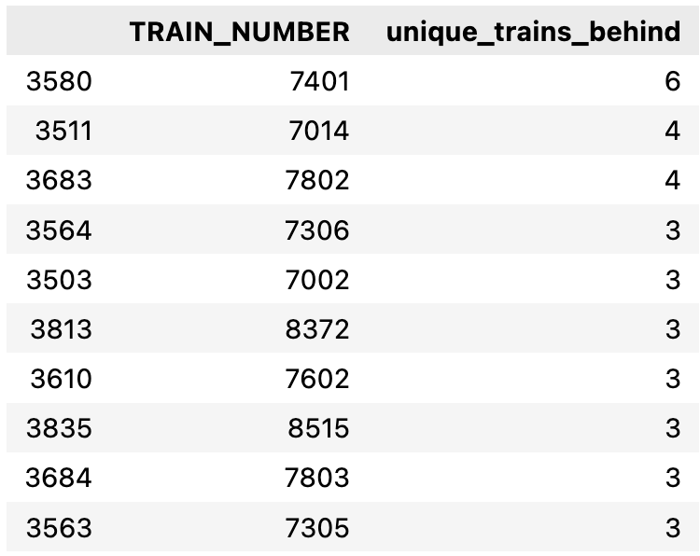
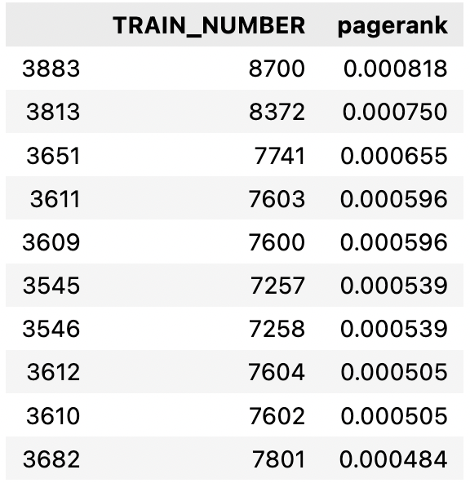
Network: Most Blocking Train Numbers
How many times is the P-train
ahead of another train?
How many different trains is the P-train ahead of?
High pagerank: P train is ahead of lots of other trains, but not often behind others
(i.e. blocking but not blocked)
12/19

Slide 13
Network: Problematic P-trains?
8700: Leval - Louvain-la-Neuve
8372: Bokrijk - Hasselt
7741: Leval - Schaarbeek
7603: Ottignies - Brussel-Zuid
7600: Marloie - Brussel-Zuid
8 out of top 10 pagerank trains are morning trains
Although evening trains do worse in general
13/19

Slide 14
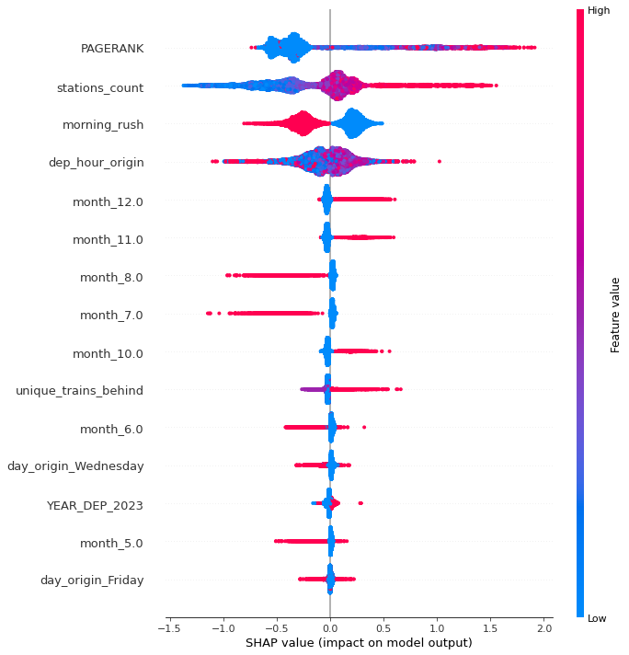
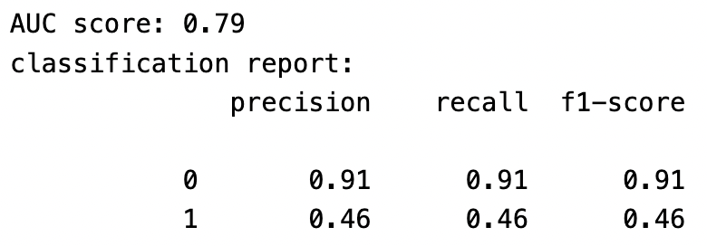
Model Performance
Train Perf
Pagerank (5m)
unique_trains_behind (5m)
= indegree
14/19

Slide 15
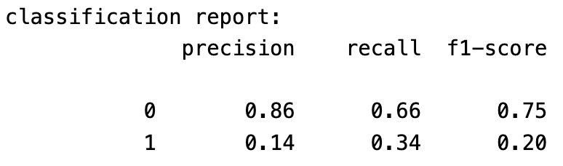
Model Performance vs. Random
Train Perf
Pagerank (5m)
unique_trains_behind (5m)
= indegree
15/19

Slide 16
Line Section Performance
16/19

Slide 17
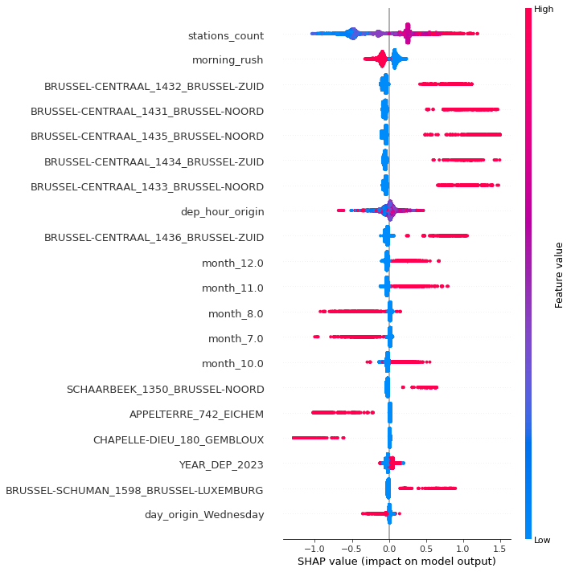
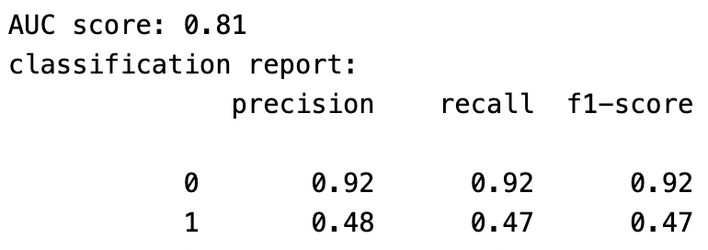
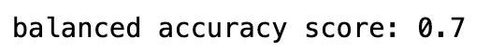
Good/Bad Line Sections
Usual suspects in Brussels
Fully utilised?
1350 Schaarbeek - Br. Noord
85, 159, 1352 and 1354 also available
Shift line section usage?
17/19

Slide 18
Network Features vs. Line Section Features
Network features:
Can replace all line sections
Computes faster
scalable for new trains
Near-identical performance
Slight loss of interpretability
lose exact location, still determined by shared section/direction
18/19

Slide 19
Closing: Q&A
Our next steps:
Preparation for mid-term meeting
Expectations?
more work on specific P-trains and line-sections
19/19

Slide 20
End

Slide 21
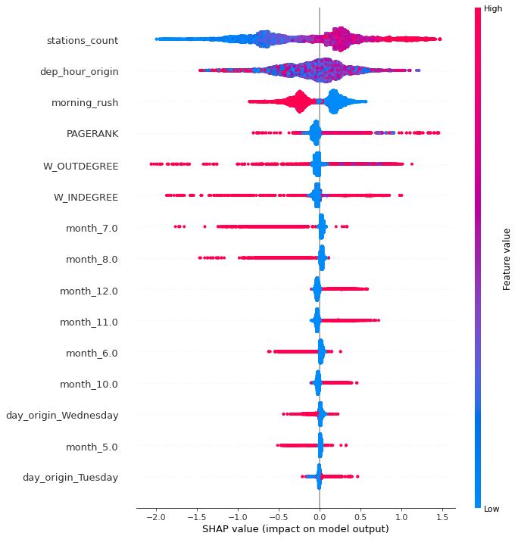
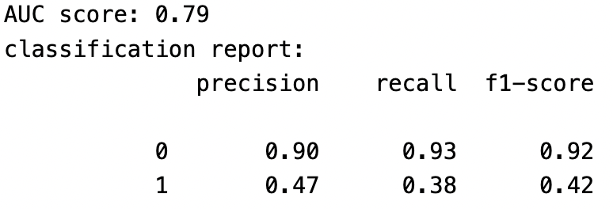
Back-up slide 1:
Train Perf
Pagerank (3m)
W-indegree (3m)
W-outdegree (3m)

Slide 22
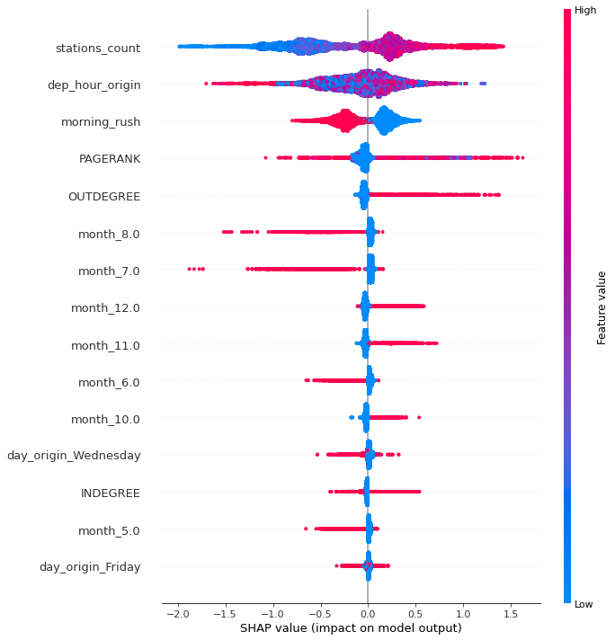
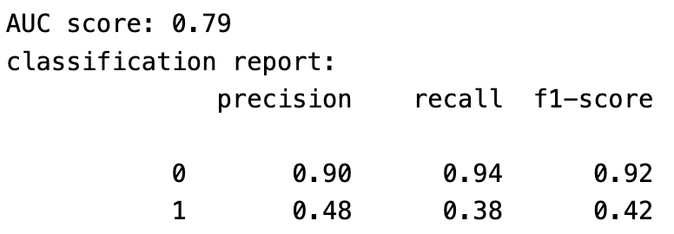
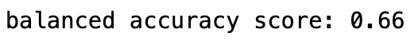
Back-up slide 2:
Train Perf
Pagerank (3m)
indegree (3m)
outdegree (3m)

Slide 23
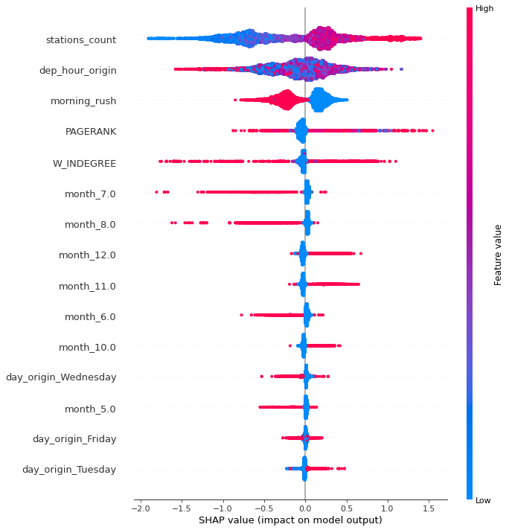
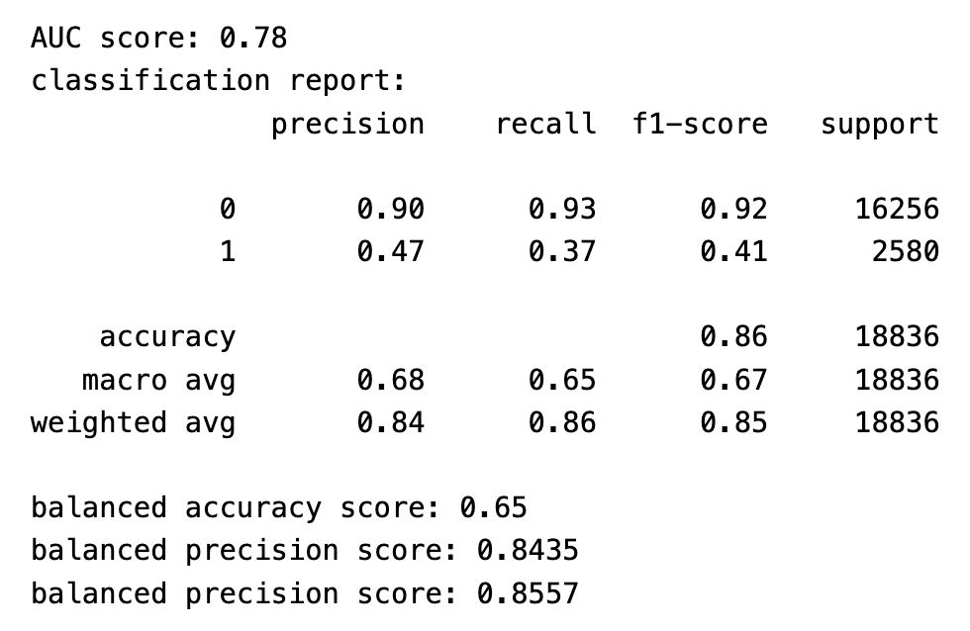
Back-up slide 3:
Train Perf
Pagerank (3m)
W-indegree (3m)

Slide 24
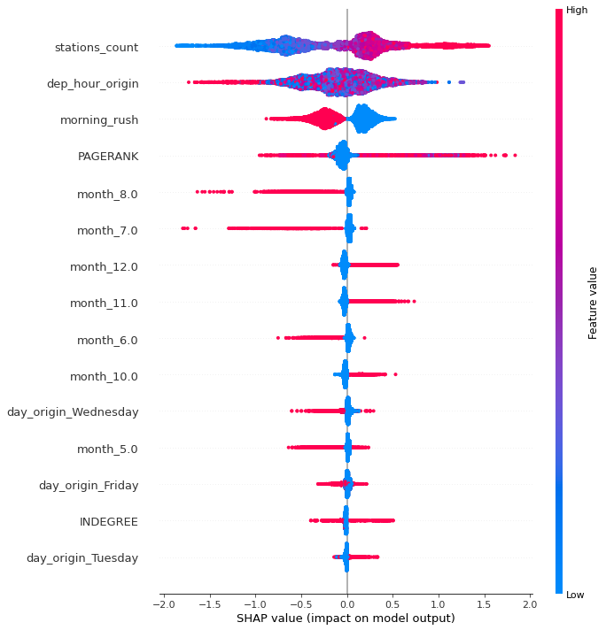
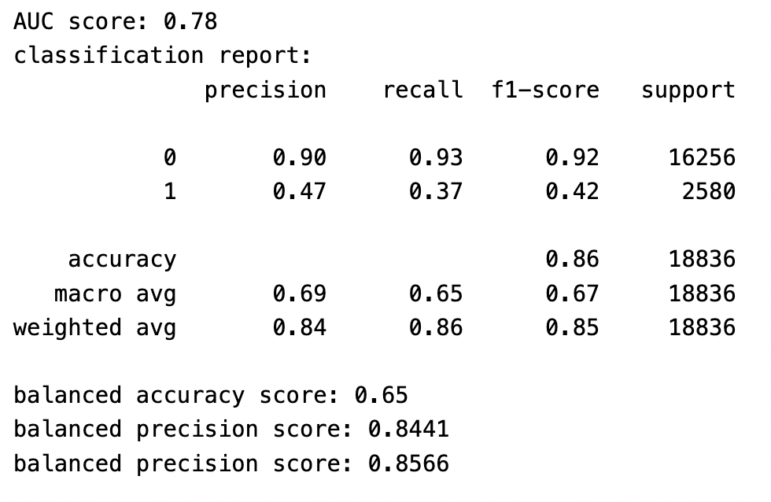
Back-up slide 4:
Train Perf
Pagerank (3m)
indegree (3m)

Slide 25
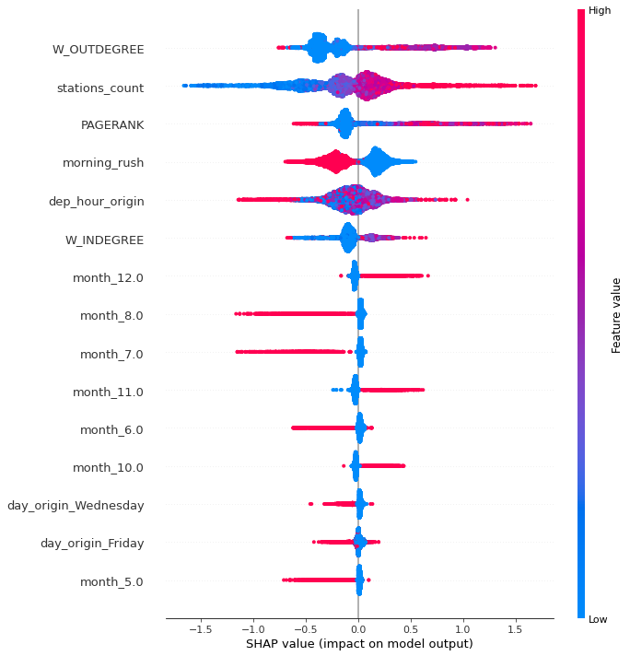
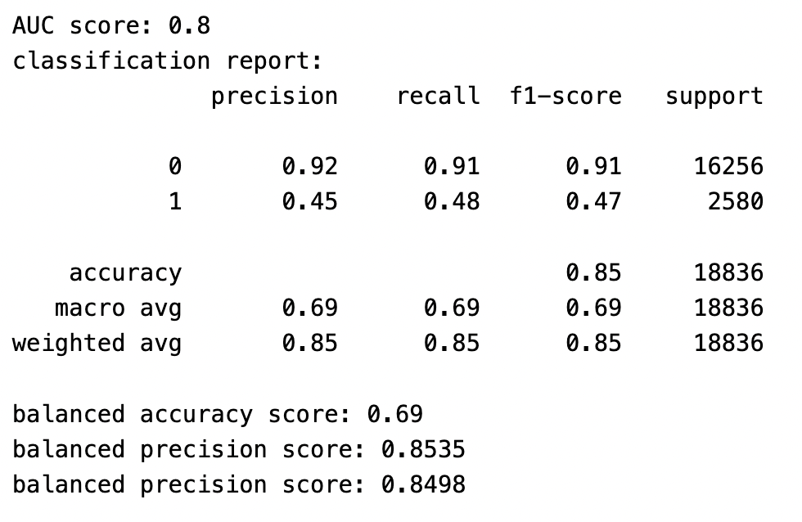
Back-up slide 5:
Train Perf
Pagerank (5m)
W-indegree (5m)
W-outdegree (5m)

Slide 26
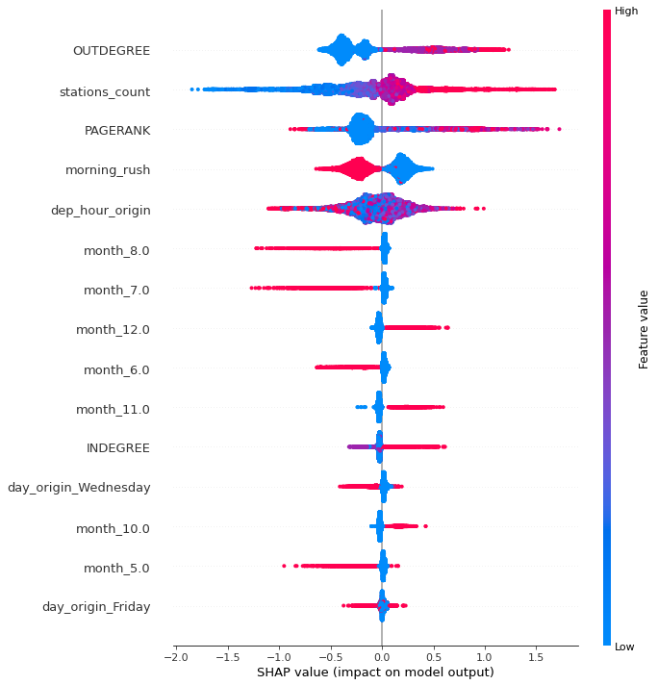
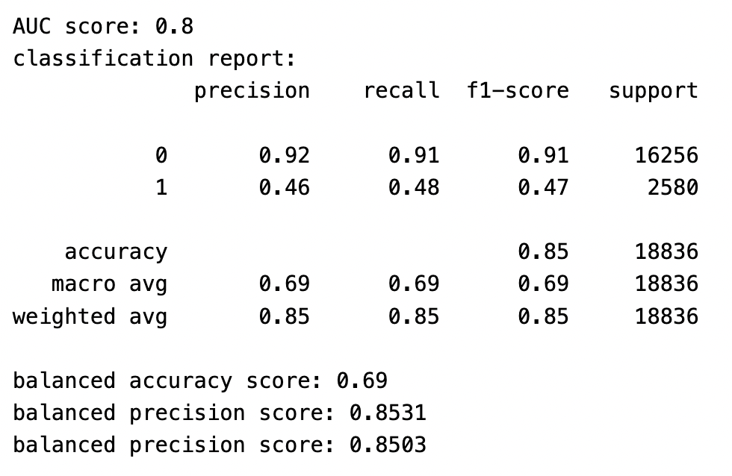
Back-up slide 6:
Train Perf
Pagerank (5m)
Indegree (5m)
Outdegree (5m)

Slide 27
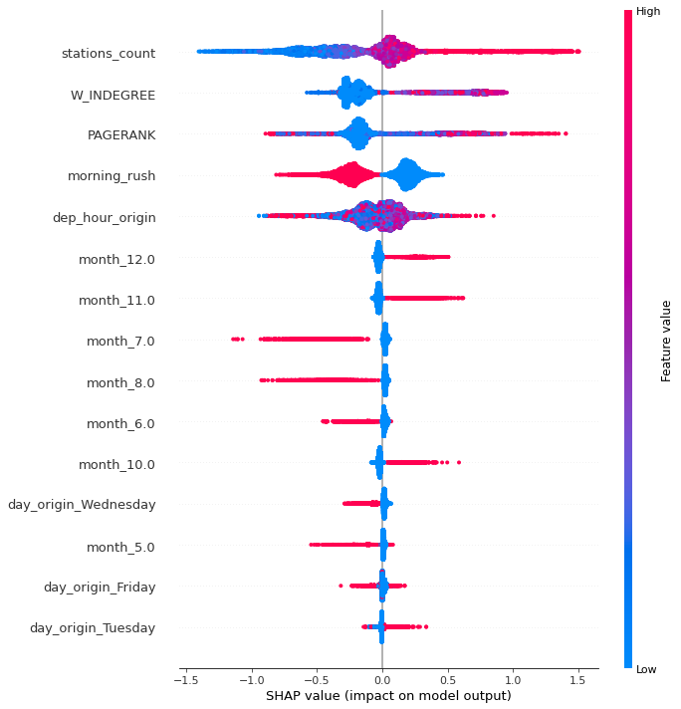
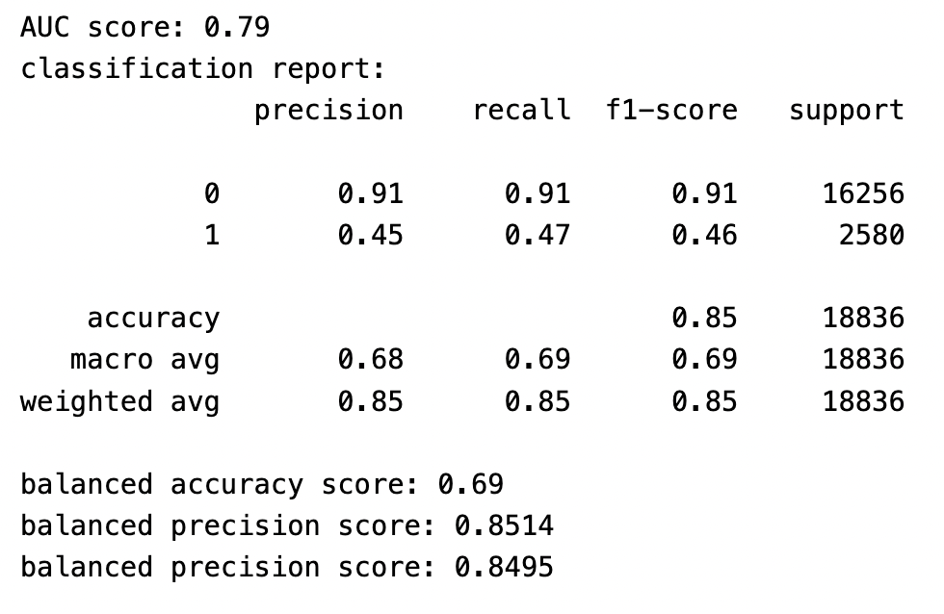
Back-up slide 7:
Train Perf
Pagerank (5m)
W-Indegree (5m) = times_ahead

Slide 28

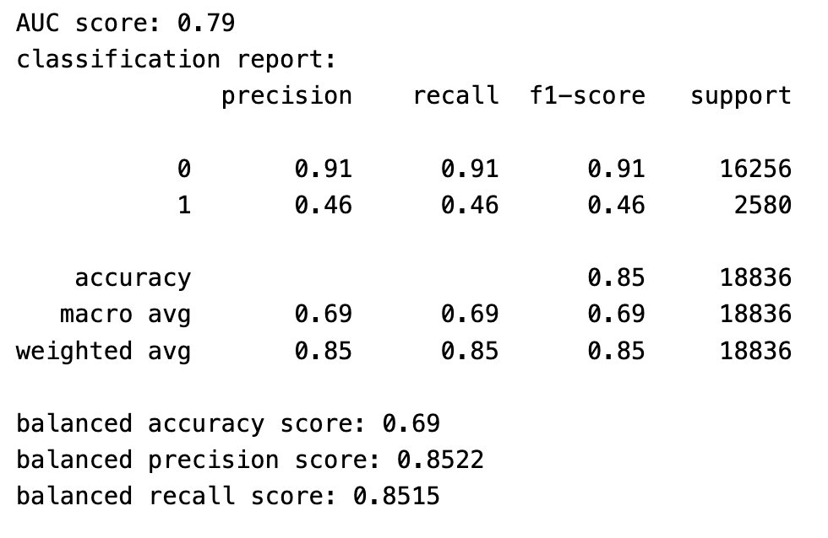
Back-up slide 8:
Train Perf
Pagerank (5m)
Indegree (5m)

Slide 29
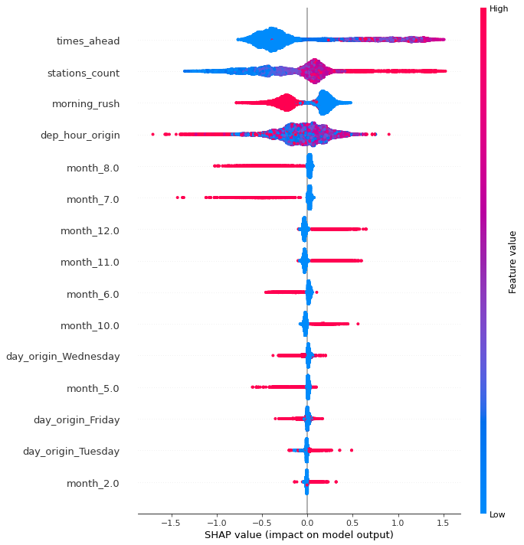
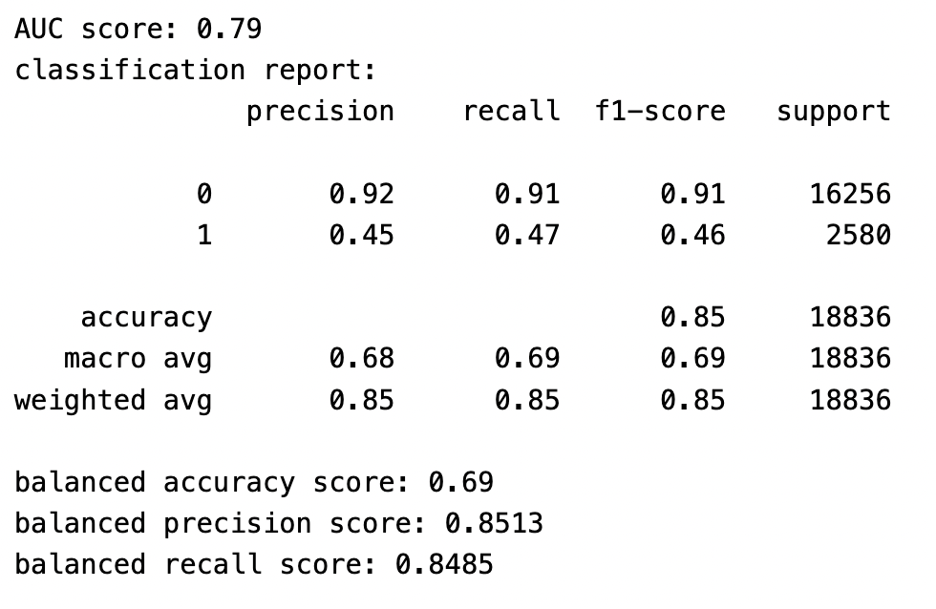
Back-up slide 9:
Train Perf
Indegree (5m)

Slide 30
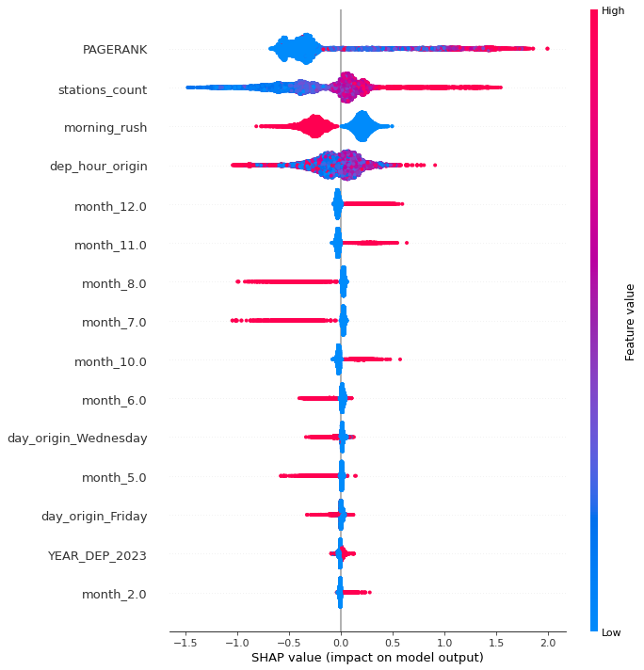
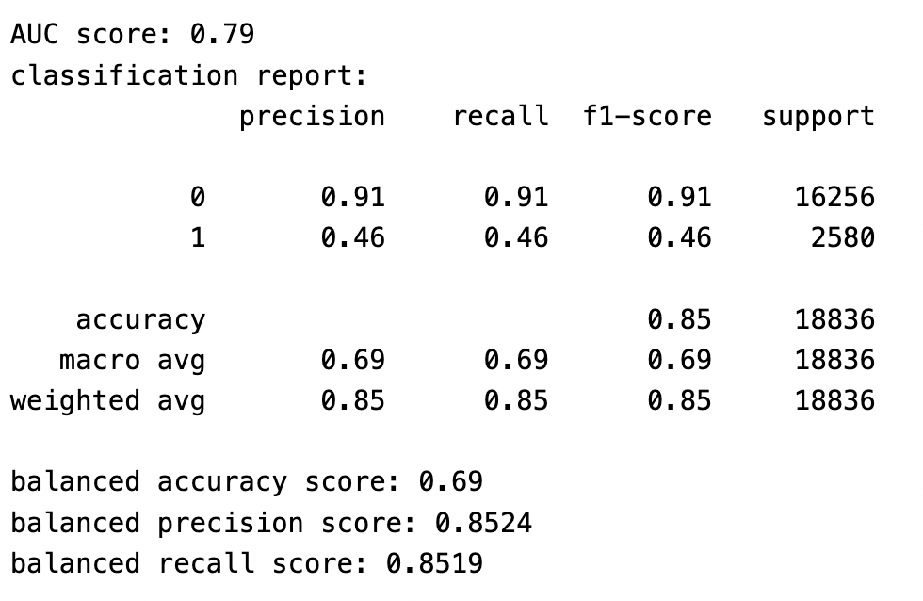
Back-up slide 10:
Train Perf
Pagerank (5m)

Slide 31
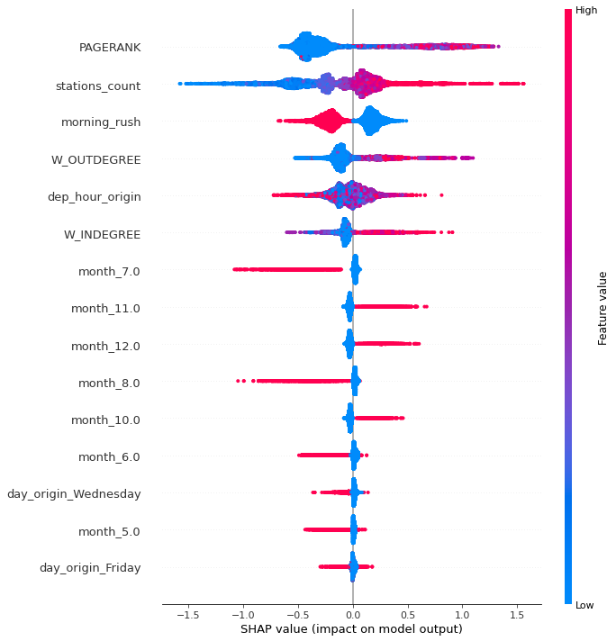
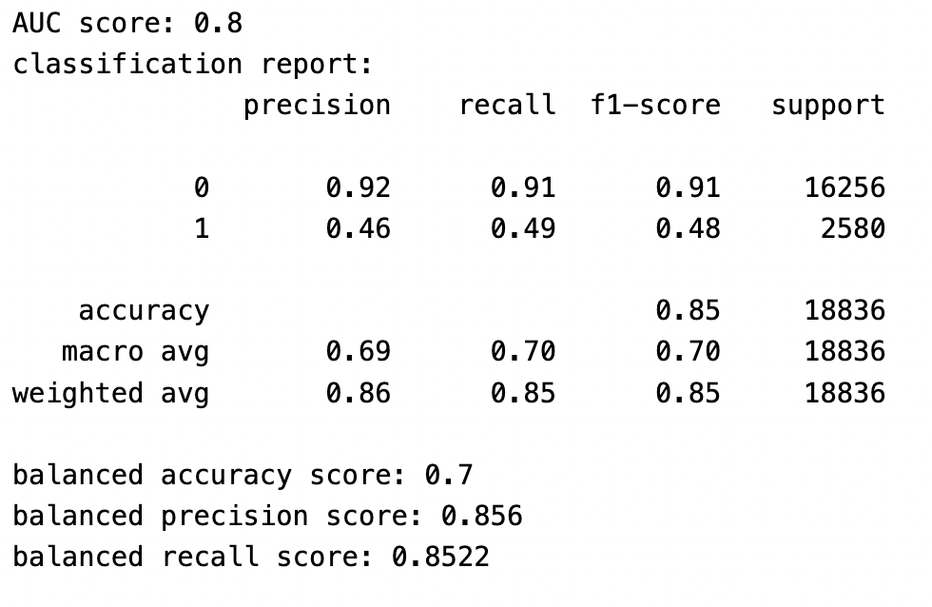
Back-up slide 11:
Train Perf
Pagerank (7m)
W-indegree (7m)
W-outdegree (7m)

Slide 32
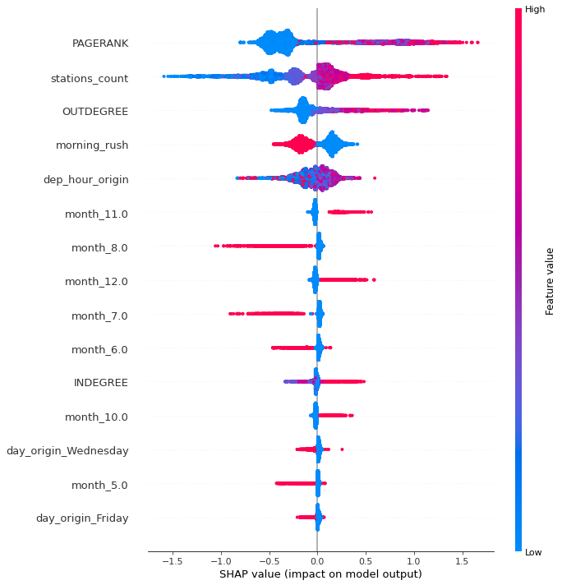
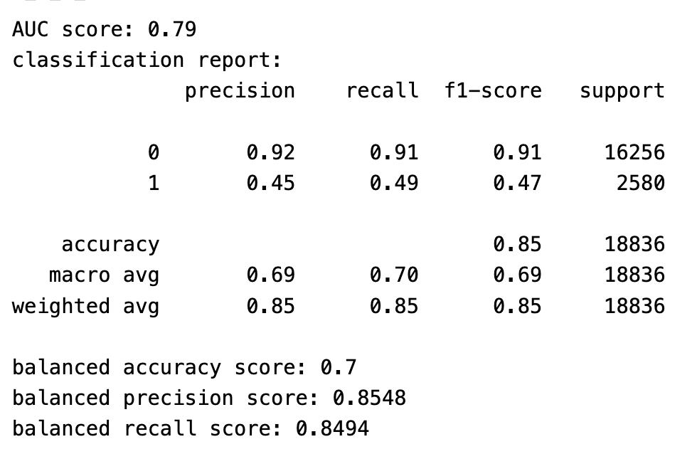
Back-up slide 12:
Train Perf
Pagerank (7m)
Indegree (7m)
Outdegree (7m)

Slide 33
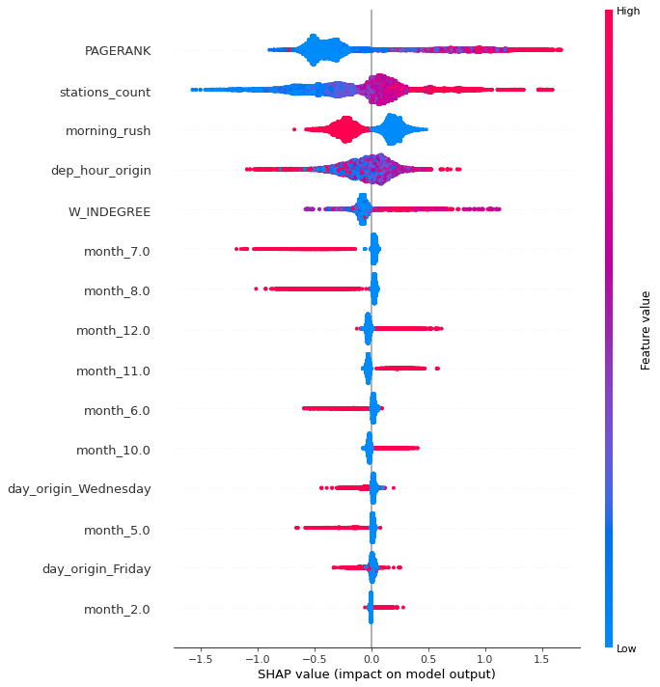

Back-up slide 13:
Train Perf
Pagerank (7m)
W-Indegree (7m)

Slide 34
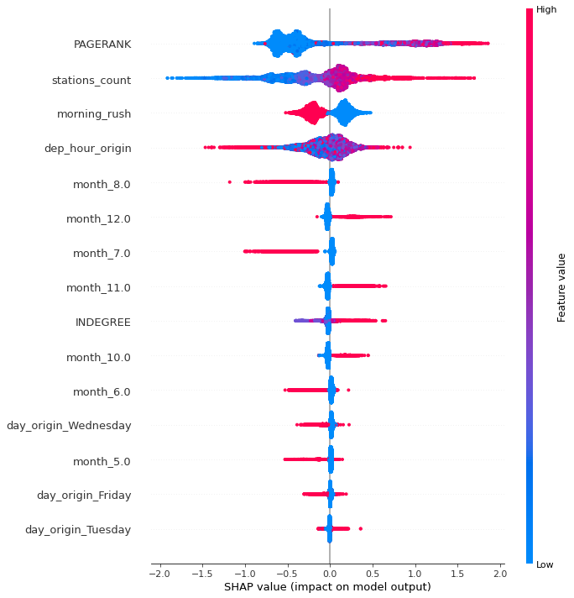

Back-up slide 14:
Train Perf
Pagerank (7m)
Indegree (7m)

Slide 35
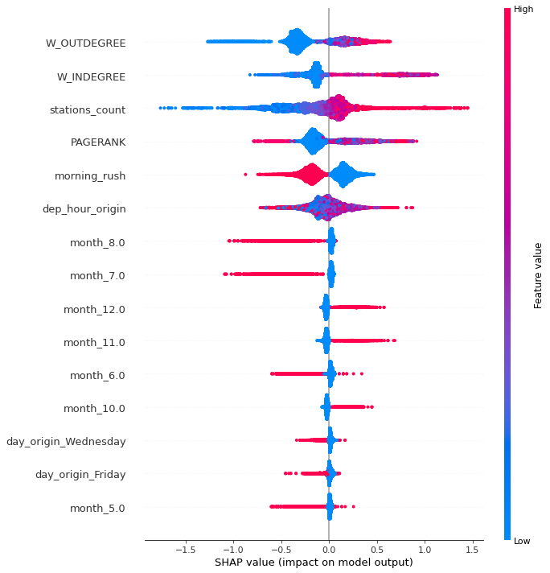
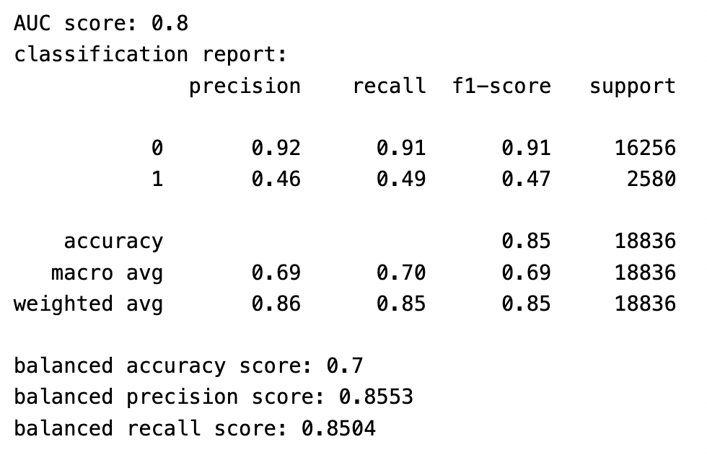
Back-up slide 15:
Train Perf
Pagerank (10m)
W-indegree (10m)
W-outdegree (10m)

Slide 36


Back-up slide 16:
Train Perf
Pagerank (10m)
Indegree (10m)
Outdegree (10m)

Slide 37
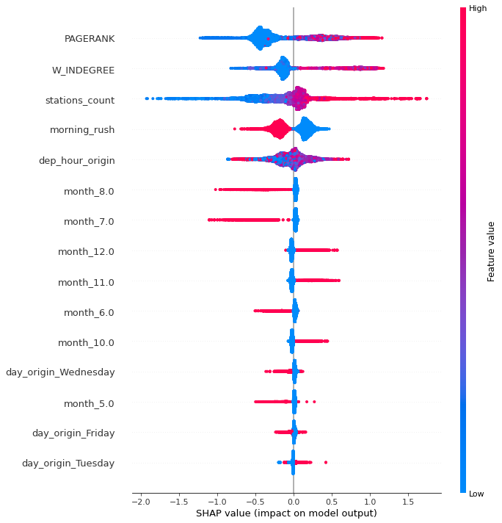
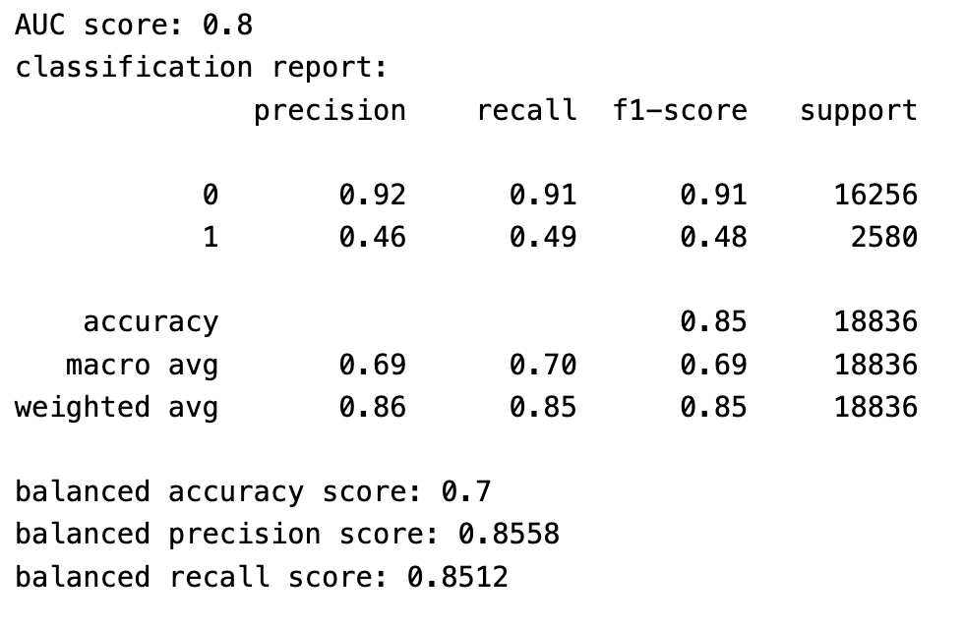
Back-up slide 17:
Train Perf
Pagerank (10m)
W-Indegree (10m)

Slide 38
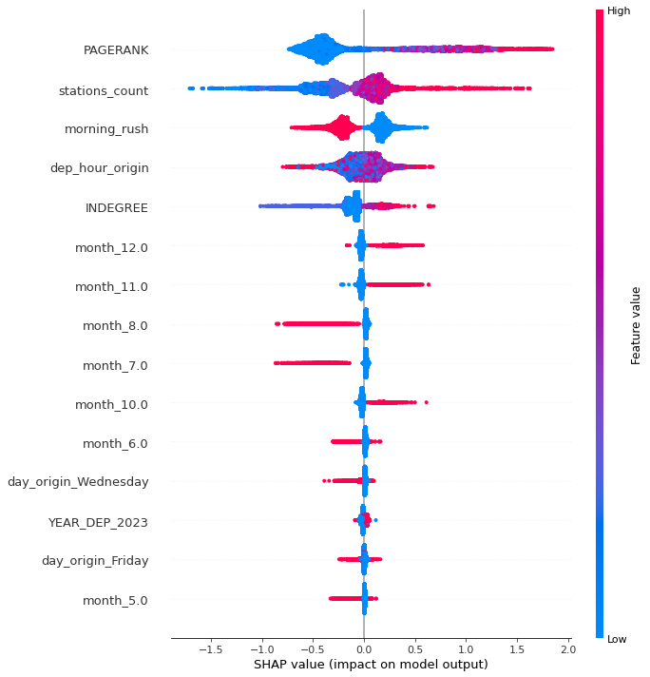
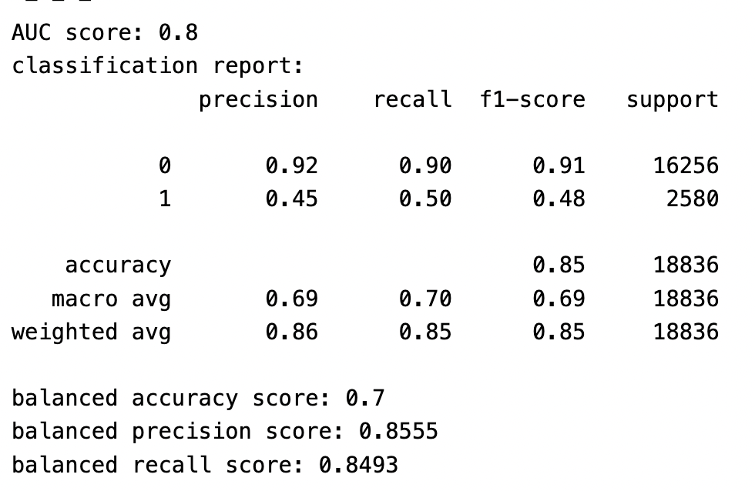
Back-up slide 18:
Train Perf
Pagerank (10m)
Indegree (10m)

Slide 39
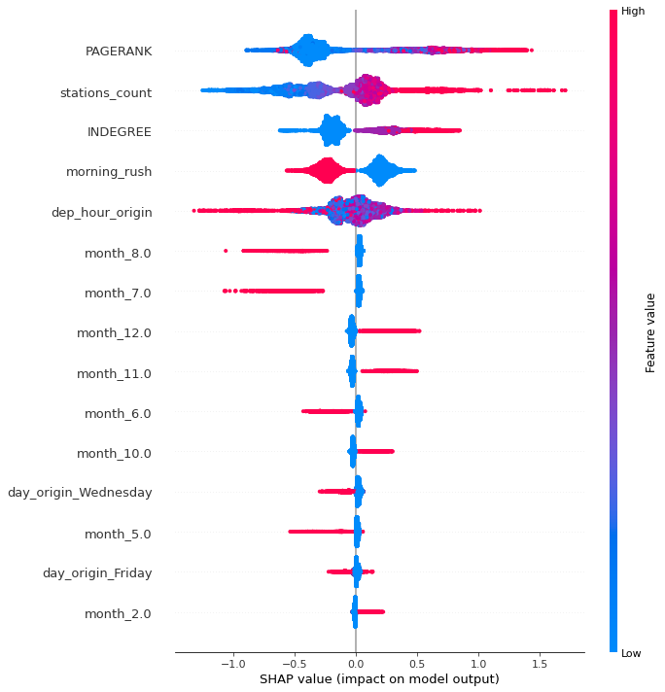
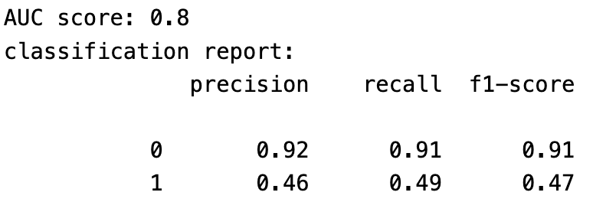
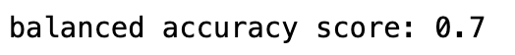
Back-up slide 19:
Train Perf
Pagerank (10m)
Indegree (5m)
params tuned

Slide 40
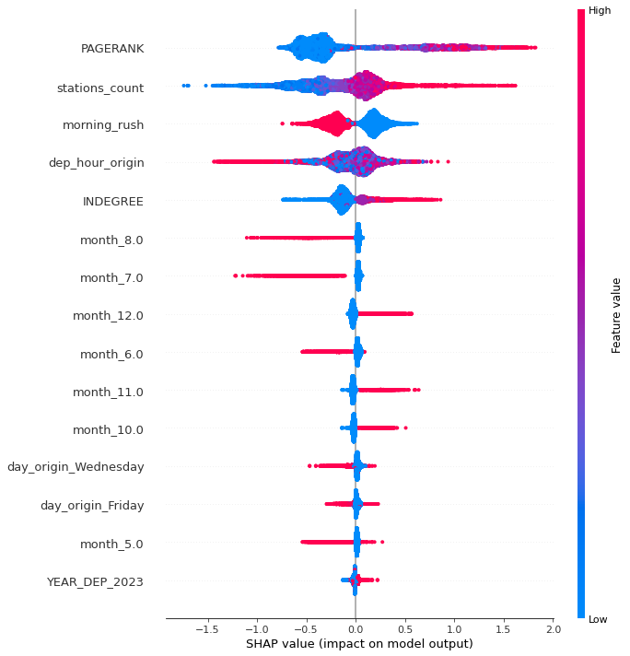
Back-up slide 20:
Train Perf
Pagerank (10m)
Indegree (5m)
untuned

Slide 41
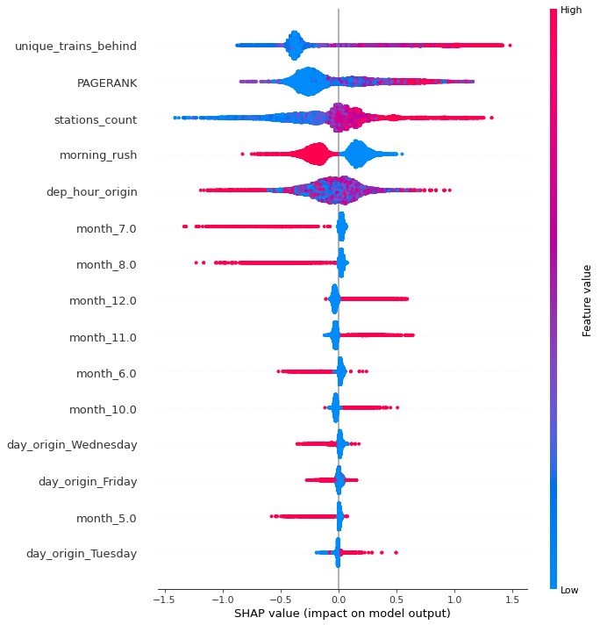

Back-up slide 21:
Train Perf
Pagerank (15m)
Indegree (15m)

Slide 42


Back-up slide 22:
Train Perf
Pagerank (15m)

Slide 43


Back-up slide 23:
Train Perf
W-Indegree (15m)
W-Outdegree

Slide 44


Back-up slide 24:
Train Perf
Pagerank (15m)
W-Indegree (15m)
W-Outdegree (15m)

Slide 45


Back-up slide 25:
Train Perf
Pagerank (15m)
Indegree (15m)
Outdegree (15m)

